Slide 1


SAP HANA DATABASE
Mihnea Andrei
SAP Products & Innovation HANA Platform July 8, 2014
Public

Slide 2
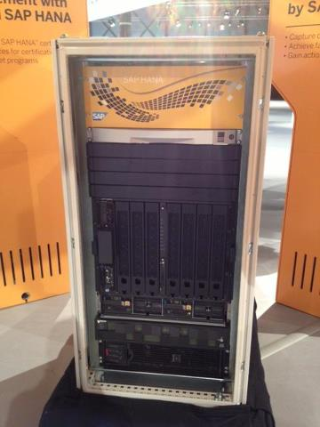
Agenda
SAP
SAP HANA DB Background
Architecture
Column Store & Compression
Snapshot Isolation
Outlook

Slide 3

SAP

Slide 4


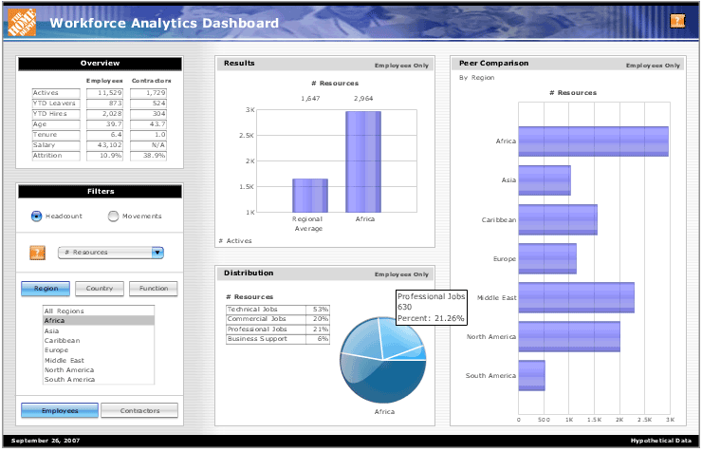
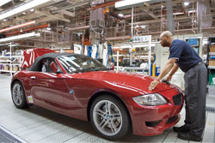

Who was SAP (before HANA)?
Sales Order
Management
Financial/Mgmt
Accounting
Business
Intelligence
Production Planning
Talent Management
Notes:
From Paul Hofmann presentation at Berkeley, about 2010, with “before HANA” added to title. Not a standard SAP slide, but it’s a good set of visual pictures.
Before HANA, SAP supplied applications (Business Suite) that helps enterprises around the world run their businesses, with capabilities for ERP (Enterprise Resource Planning) so that production and sales work well, back-office financial accounting, customer relationship management, talent management and business warehouses and businesses intelligence to help enterprises monitor and run their businesses better.

Slide 5

74% of the world’s transaction revenue
touches an SAP system.
Notes:
Taken from Fast_Facts_English_1-2014 year end update, a strategy presentation on the portal; look at The link to external certified content is here: https://portal.wdf.sap.corp/wcm/ROLES://portal_content/com.sap.sen.employee.employee/com.sap.sen.employee.global/com.sap.sen.employee.roles_0_0/com.sap.sen.employee.rl_employee_global/companyII/about_sap/corp_profile/Infocenters/Global%20Communications%20for%20SAP/About%20SAP/SAP%20Corporate%20Profile&isWcmsNavRoot=true
This is how enterprises run their businesses and do planning for the future—how they allocate resources and make money. Maybe you don’t see SAP’s services directly, but they has a big effect on your lives, since 74% of the world’s transaction revenue goes through an SAP system at some time.

Slide 6
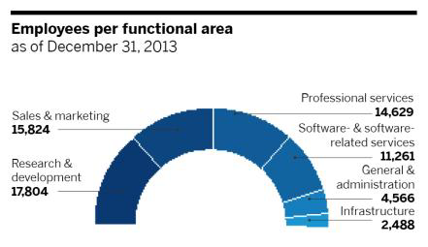
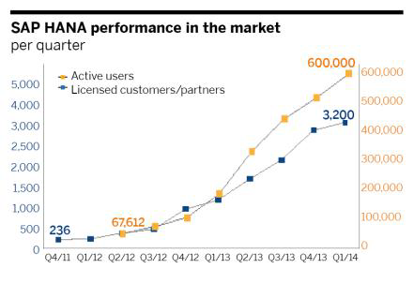
SAP
Business Applications – Database & Technology – Analytics – Cloud – Mobile
Annual revenue (IFRS) of € 16,82 billion
More than 253,500 customers in 188 countries
More than 66,500 employees – and locations in more than 130 countries
A 42-year history of innovation and growth as a true industry leader

Slide 7
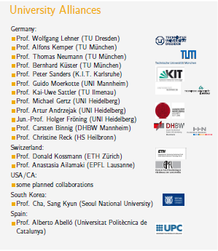

Slide 8
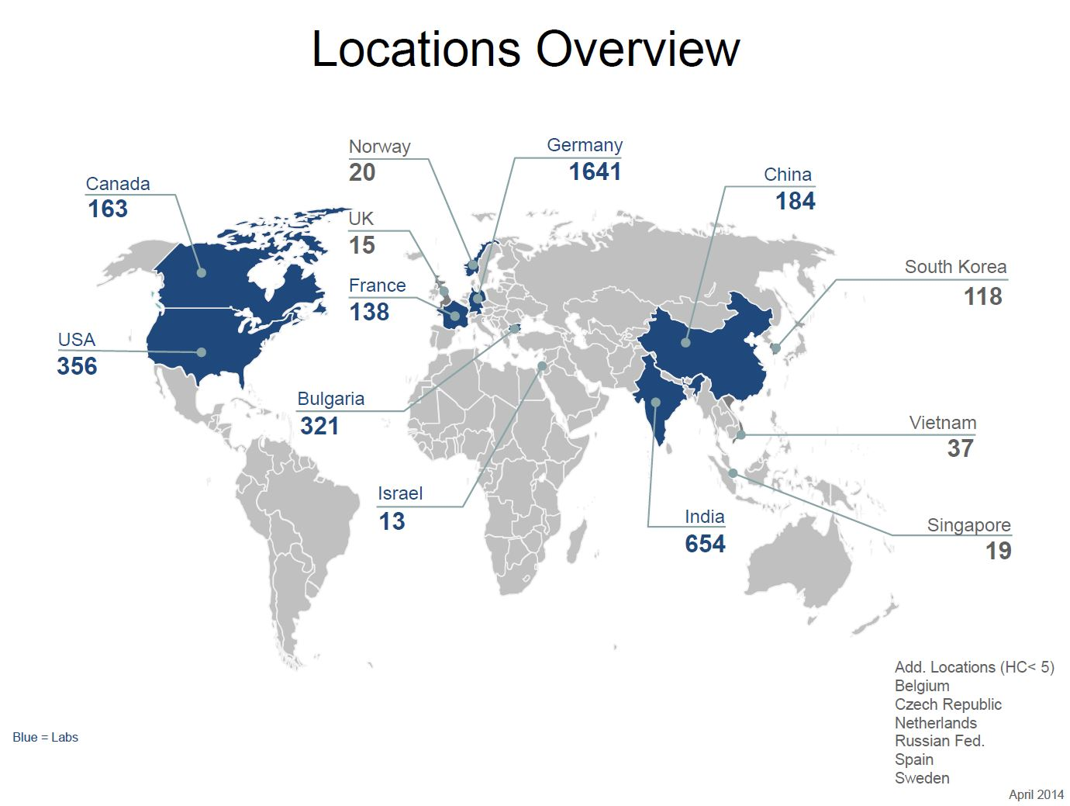
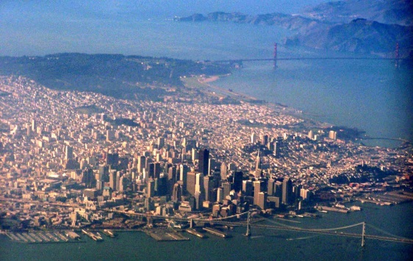
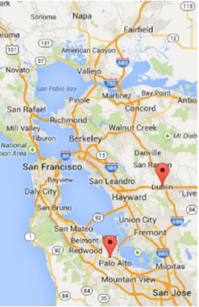

Products & Innovation HANA Platform
California Campus – Worldwide

Slide 9
SAP HANA DB Background
Why did we build HANA?

Slide 10
How Did the SAP Use Database Before HANA?
See “The SAP Transaction Model: Know Your Applications”, SIGMOD 2008 Industrial Talk
    Database was mainly a dumb store …
      Retrieve/Store data (Open SQL, no stored procedures)
      Transaction commit, with locks held very briefly
      Operational utilities
    … because SAP kept the following in the application server:
      Application logic
      Business object-level locks
      Queued updates
      Data buffers
      Indexes
With the HANA platform, computation-intensive data-centric operations are moved to the Database
Notes:
Based mostly on the referenced source,
“The SAP Transaction Model: Know Your Applications”, SIGMOD 2008 Industrial Talk.
Before HANA, SAP used a variety of different databases, but we used them mainly as dumb file systems. We read data out of the databases using a simple database interface (OPEN SQL), but we didn’t execute stored procedures in the database, nor did we hold locks in the database. We didn’t want to depend on the features of any specific database product, and we didn’t want the database to be a bottleneck.
Instead, we read data from the DB and executed application logic in scalable application servers, which had their own data buffering, business-object level locks, queues of updates, and even their own indexes. Only when a transaction committed where the queued updates applied to the underlying database system.
This was a great approach for application server scale-out, database-independence, and use of hardware at the time that our Business Suite was written.
But with HANA, we take advantage of modern hardware and move computation-intensive operations on data to the database, avoiding the copying and representation transformation and non-locality and many other issues of the pre-HANA approach!

Slide 11
DRAM Price/GB
Year | Price/GB
2013 | $5.50
2010 | $12.37
2005 | $189
2000 | $1,107
1995 | $30,875
1990 | $103,880
1985 | $859,375
1980 | $6,328,125
Source: http://www.statisticbrain.com/average-historic-price-of-ram/
Notes:
Building a main memory database in the 1980’s for a large database would have been absurd (over $6B/GB in 1980!). And DRAM was still quite expensive in the 1990’s; Jim Gray was talking/writing about the challenges of TerrorBytes (not a typo) in 1995. But one TB in 2013 only costs $5500 based on these numbers, making main memory database
[The numbers from source mentioned above, http://www.statisticbrain.com/average-historic-price-of-ram/
Note that DRAM prices are tricky, given differences (ECC, enterprise class, etc.), but this shows the trend over 33 years on DRAM prices that makes large main memories so important.]

Slide 12
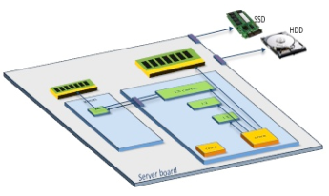
In-Memory Computing
CPU
4-8 sockets
Core
Core
4-12 cores/CPU
L1 Cache
L1 Cache
1 NS, 64K/core
L2 Cache
L2 Cache
3 NS, 256k/core
L3 Cache
8 NS, >2M shared
    Yes, DRAM is 125,000 times faster than disk, but DRAM access is still 10-80 times slower than on-chip caches
Main Memory
80 NS, TBs
Disk
SSD: 100K NS
HD: 10M NS
Using Intel Ivy Bridge for approximate values.
Actual numbers depends on specific hardware.
Notes:
Originally from Stanford EE Computer Systems Colloquium v1.0 by Chris Hallenbeck; see http://ee380.stanford.edu/Abstracts/130522-slides.pdf
But instead of using the usual but somewhat outdated Google “Numbers Everyone Should Know” numbers from Peter Norvig/Jeff Dean switched to Renu Raman's Ivy Bridge numbers numbers (0.25 ns clock; L1 1 ns; L2 3 ns; L3 8 ns) but used 100K ns for SSD (not 75K) just to be round, and 100M ns for HDD.
On this slide, talk about how “locality is key”; it’s not just about moving from disk (or even SSD) to DRAM, but also use of caches, since on-chip cache access is still 10-80X faster than accessing DRAM. The 80ns figure is a little bogus; it’s a simplification to avoid having to mention time of 60ns to access DRAM on the cpu versus 100ns to access DRAM on another cpu.

Slide 13
Enterprise Workloads are Read Dominated
  Workload in Enterprise Applications consists of:
    Mainly read queries (OLTP 83%, OLAP 94%)
    Many queries access large sets of data
Notes:
From lecture notes by Jan Schaffner of HPI/SAP, filename CD216TechEd-Amsterdam-2013-Schaffner.pptx
What are enterprise applications like? You may be familiar with benchmarks like TPC-C for OLTP (shown on the right) and TPC-H for Decision Support. These benchmarks don’t really match enterprise applications. Each customer may have their own applications, but SAP analyzed the workload of 12 enterprise customers, and the charts above show what we found. The main finding is that reads strongly dominate workloads for both OLTP (83% of workload) and OLAP (94% of workload).
So although it’s important to design for both reads and modifications (inserts, updates and deletes), we need to keep these numbers in mind when designing a data management system.

Slide 14

Simplify Technology Stack with the SAP HANA Platform
Insight to Action
Contextual. Real-time. Closed-loop.
Applications
Analytics
SAP HANA Platform
Notes:
Modification of slide and notes in SAP_corpstory_20140130 from the portal; also in SAP_corpstory_20140212; see QuickLink /go/sapstory and JAM strategy site, https://jam4.sapjam.com/groups/about_page/5K3uB4UpsE3nWnix6Apvz6
1st, we start by simplifying customer’s core technology stack
At the foundation of our innovation and strategy is SAP HANA. With SAP HANA as the common platform, we help our customers dramatically accelerate the speed of their business while radically simplifying their IT stack by collapsing complex IT layers reducing hardware costs.
In addition, the SAP HANA platform brings the seamless integration across our core applications and analytics (and decision support) solutions, offering a truly integrated closed-loop experience from insight to action
Previous slide described the past, before HANA. But now, with the SAP HANA platform, the technology stack is simplified. Applications run on the HANA platform, producing insights in real-time based on current data, based on the user’s context (e.g., role, location, history). Using SAP analytics users turn those insights into action, closing the loop.

Slide 15
SAP HANA Database Background
BWA / BIA
Trex
Enterprise Search
NewDB / HANA
BW on HANA
Suite on HANA
HANA Platform
MaxDB
PTime
Sybase IQ/ASE/SA/RS/etc.
Ancient times
2000-2009
2010
2011
2012
now

Slide 16
SAP HANA DB Architecture

Slide 17
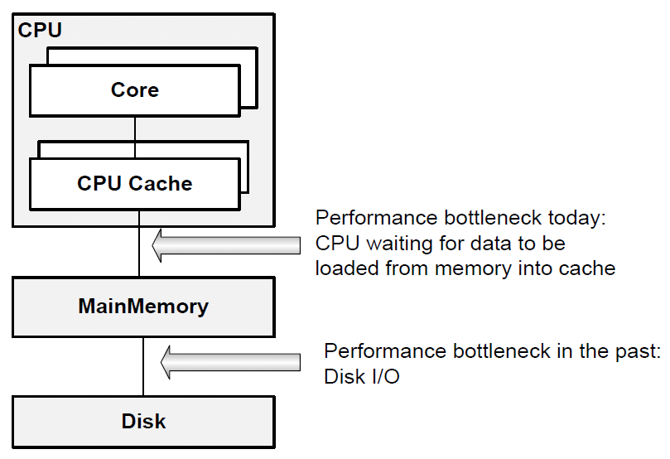
Technological Context
Multi-Core CPUs
  Clock speed does not increase
  More CPU cores
  Small cache in CPU
Large Memory
  1 TB RAM widely available
  Slow compared to CPU
  Disk
  “Unlimited” Size
  Increasing Latency gap
Notes:
Cache-Speed
L1 32+32kB per Core; 3 cycles
L2 256kB per Core; 8 cycles
L3 >6MB per CPU; 30 cycles
Memory Technology
Mid-1980s 2011 Improvement
RAM capacity 64 kB 1 TB 15.6 Mio x
Maximum transfer rate 2 MB/s 32 GB/s 16000x
Latency XXX 15 ns XXXX
Disk Technology
Mid-1980s 2011 Improvement
Disk capacity 30 MB 2 TB 66667x
Maximum transfer rate 2 MB/s 100 MB/s 50x
Latency (seek + rotate) 20 ms 10 ms 2x

Slide 18
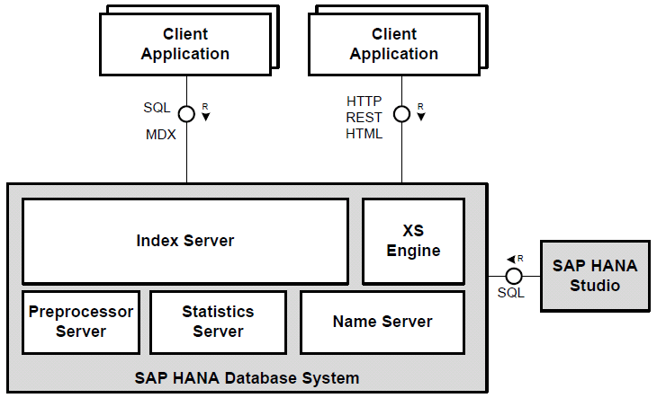
SAP HANA DB Processes
Notes:
Landscape:
Logical System with multiple nodes
Each node with on SAP HANA System connected via SID / InstanceID
Front End
HTTP-Server (ICM)
WebDispatcher
XS-Engine
JS-Runtime
Other app-runtimes

Slide 19
Business Applications
Connection and Session Management
Authori-zation Manager
SQL
SQL Script
MDX
…
Trans- action Manager
Optimizer and Plan Generator
Calculation Engine
Execution Engine
Metadata Manager
In-Memory Processing Engines
Column Engine
Row Engine
Text Engine
Persistency
Logging and Recovery
Data Storage
Notes:
MDX:
multi-dimensional expressions -> OLAP cubes
ColStore Layout
delta-main
Delta-dictionary (unordered array of values (append new values) + search tree for lookup)
Main-dict (ordered: value->id; inverted index: id->row)
Consitent view (bit vector)
Text in Main
First string of page: Length of first value -> value
Next string(s): length of common prefix -> remaining size -> rest data

Slide 20
Distributed Share-Nothing In-Memory Computing

Slide 21
Column Store
& Compression

Slide 22
Motivation: Customer System Sizes (Medium-Sized)
 | Customer 1 | Customer 2 | Customer 3 | Customer 4
Row Store (GB) | 168 | 237 | 144 | 184
Column Store (GB) | 370 | 413 | 911 | 733
Other internal data structures (GB) | 168 | 237 | 144 | 184
Total heap memory used (GB) | 538 | 650 | 1055 | 917
System X Table Size (GB) | 949 | 1550 | 3180 | 1870
System X Total DB Size (GB) | 1500 | 2520 | 5270 | 4490
“Within the last (exactly) three months, we managed to reduce the memory footprint NewDB (for a sample BW system) from initially 480 Gb to now 160 Gb, thus saving customers  Euros licensing costs and making the compression rates even more competitive.”
Sizing Tool for BW on HANA: http://service.sap.com/quicksizer

Slide 23
SAP HANA Technology
Hybrid Data Storage
Tuple 1
SAP HANA Row Store
stores tables by row
SAP HANA Column Store
stores tables by column
Tuple 2
Att1
Tuple 3
Att2
Att3
Att4
Att5
Att1
Att2
Att3
Att4
Att5
Tuple 1
Tuple n
Tuple 2
Tuple 3
Tuple n
  Application often processes single records at once
    many selects and /or updates of single records
  Application typically accesses the complete record
  Columns contain mainly distinct values
  Aggregations and fast searching not required
  Small number of rows (e.g. configuration tables)
  Search and calculation on values of a few columns
  Big number of columns
  Big number of rows and columnar operations
    aggregate, scan, etc.
  High compression rates possible
    Most columns contain only few distinct values

Slide 24
SAP HANA Technology
Dictionary Compression & N-bit Compression
Classical Row Store
HANA Column Store
Company [CHAR50] | Region [CHAR30] | Group [CHAR5]
INTEL | USA | A
Siemens | Europe | B
Siemens | Europe | C
SAP | Europe | A
SAP | Europe | A
IBM | USA | A
0 INTEL
1 Siemens
2 SAP
3 IBM
0 A
1 B
2 C
Dictionary for attribute/
column „Group“
0 Europe
1 USA
0
1
0
1
0
1
Index Vector
Stored in one memory chunk
=> data locality for fast scans
1
0
2
2
0
0
2
0
0
3
1
0

Slide 25
SAP HANA Technology
Compression with run length encoding
Classical Row Store
Difficult to compress
HANA Column Store:
Dictionary compressed
HANA Column Store:
Run length compressed*
0 INTEL
1 Siemens
2 SAP
3 IBM
0 A
1 B
2 C
0 INTEL
1 Siemens
2 SAP
3 IBM
0 A
1 B
2 C
Company [CHAR50] | Region [CHAR30] | Group [CHAR5]
INTEL | USA | A
Siemens | Europe | B
Siemens | Europe | C
SAP | Europe | A
SAP | Europe | A
IBM | USA | A
0 Europe
1 USA
0 Europe
1 USA
0
1
0
1 x „0“
1 x „1“
1 x „0“
1
0
1
2 x „1“
4 x „0“
1 x „1“
1
0
2
2 x „2“
1 x „1“
1 x „2“
2
0
0
1 x „3“
3 x „0“
2
0
0
3
1
0
* Note that there is a variety of compression methods
and algorithms like run-length compression

Slide 26
SAP HANA Technology
Dictionary Compression
Dictionary (Main Storage)
  Sorted array of values
  Implicit value ID = position in array
  Lookup by binary search: works like index
  For strings data: additional front-coding
  Column stored as value ID sequence
    Bit coded using log₂(N_{DICT}) bits
  Fast comparison ( =, < , > ) on integers
  Speeds up scan, join, region queries
  Dictionary (Delta)
  Unsorted array
  For lookup: search tree (CSB+ tree)
  Search
  Find Value in dictionary
  scan value ID sequence for occurrences
  Optional index:
    For each value in dictionary list of rows with value

Slide 27
SAP HANA Technology
Compression of Value ID Sequence

Slide 28
SAP HANA Technology
Dictionary Compression
HANA Bluebook, p.53

Slide 29
Snapshot Isolation

Slide 30
Initial Design – set oriented, optimized for OLAP
DATA-D……………DATA-D
111
000001……………100000000001000
011000……………001101111100111
TA-
11111
100010……………01000000010
011001……………101101111011
ATA-DA
inserted
111011……………111101
base list of rows visible to all
deleted
time
oldest reader
tx1 commit
tx2 begin
tx3 commit
tx2 access
tx4 begin
& access

Slide 31
New Design – OLTP friendly
valid
from
valid
to
tx3: delete where …
New
rows
tx2
…
tx3
tx2: insert n rows
tx1: insert 1 row
New row
tx1
DATA
tx3
Problems to solve
    Memory overhead
      Valid from/to for every row?
    Tx identity: TID vs. CID
      If TID: visibility rules, TCB memory overhead
      If CID: DML time ID, atomic commit, post-commit
    L2/3 cache friendly
      Stay local, avoid dereferencing pointers
    OLAP performance
txn: reader

Slide 32
Outlook
Where is HANA going next?

Slide 33
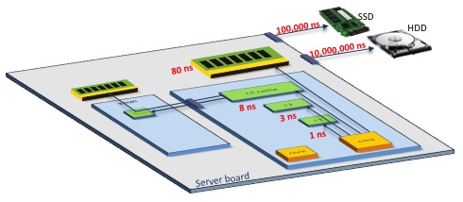
Continuing Challenges of Emerging Hardware
    Challenge 1: Parallelism: Take advantage of tens, hundreds, thousands of cores
    Challenge 2: Large memories & data locality/NUMA
      Yes, DRAM is 125,000 times faster than disk…
      But DRAM access is still 10-80 times slower than on-chip caches
Notes:
Switched to Renu Raman's Ivy Bridge number (0.25 ns clock; L1 1 ns; L2 3 ns; L3 8 ns) but used 100K ns for SSD (not 75K) just to be round, and 100M ns for HDD; switched from referencing Norvig to referencing Ivy Bridge numbers
Originally from Stanford EE Computer Systems Colloquium v1.0 by Chris Hallenbeck; also used in Anil Goel’s BrownBagNov-4-2013.
We’ve already said what’s on this slide; point is that hardware keeps changing, just as application requirements keep changing. HANA will leverage new hardware directions, and provide better capabilities to meet needs of existing and new applications.
Notes from Chris:
Critical slide!!!
Developing a database to solve these two critical challenges requires a careful design and development from the ground up of every aspect of the database. Relabeling an existing DB “in-memory” doesn’t do it. Careful optimizing for optimal cache utilization and for hundreds of parallel threads is what makes the difference, and allows HANA to reach the speeds I just discussed. I can’t over-emphasize two important solving these two challenges is to the performance of SAP HANA.

Slide 34
HANA Platform On-Going Architectural Evolution
Data models
    Flexible schemas, graph functionality, geospatial, time series, historical data,
    Big Data, external libraries
Resource and workload management
    Memory, threads, scheduling, admission control, service level management, data aging
Application services
    XS Engine, CDS and River
Continuing performance improvements
    Hardware advances, NUMA, improved modularization and architecture
Cloud and multi-tenancy
Notes:
Big modification of slide from Anil Goel’s BrownBagNov-4-2013, based on discussions with Anil
Brief list of a range of topics where HANA’s architecture is/will be extended. Not enough time (and in some cases, too early) to go into detail on these items

Slide 35
Co-innovating the Next Big Wave in Hardware Evolution
Multi-Core and Large “Memory” Footprints
Storage Class Memories / Non-Volatile Memory
    Leverage as DRAM and/or as persistent storage
On-Board DIMMs
    Very high density, byte-addressable
    DRAM like (< 3X) latency and bandwidth; similar endurance
    Compete with disk on cost/bit by 2020
Extreme Speed Network Fabric/Interconnects
    Inter-socket NUMA gets worse while inter-host NUMA gets better
    Inter-socket and Inter-host latencies converge
Exploiting Dark Silicon for Database Hardware Acceleration
    Also exploit GPUs for specific use cases, such as regression analysis
Notes:
Modified version of slide from Anil Goel’s BrownBagNov-4-2013
There will be more and more cores and larger and large memories, so different architecture for cores and memory utilization/scheduling will become appropriate, especially as network latencies converge (inter-socket and inter-host). Separate storage from computing?
Classical disk/memory separate is changing even more:
Storage Class Memories (e.g., based on spin-torque magnotoresistive RAM) are emerging memories that have performance similar to DRAM but with better persistence capabilities, potentially changing architecture.
DIMMs (dual in-line memory modules) are now standard, supporting 64 bit data bus vs 32 bit for SIMMs (single); on-board DIMMs will be disk-like in cost and DRAM like in latency/bandwidth/endurance, which also dense and byte-addressable.
Dark Silicon refers to notion that because of the same utilization barrier that led to multicore, some parts of a chip can not be powered at any given time, so they are either unused or underclocked. Computation in the presence of dark silicon offers challenges and opportunities.
Special purposes GPUs (Graphical Processing Units) could help with particular application capabilities, such as regression analysis.

Slide 36
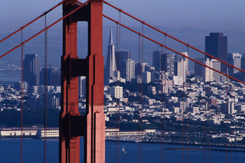
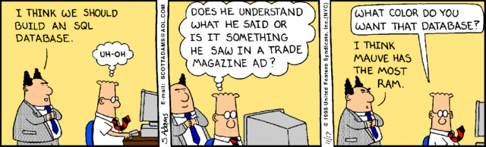
Thank you!
Contact information:
Arne Schwarz, arne.schwarzy@sap.com
Mihnea Andrei, mihnea.andrei@sap.com
Richard Pledereder, richard.pledereder@sap.com
  http://www.careersatsap.com/
  http://jobs.sap.com
https://www.saphana.com
http://www.sap.com/pc/tech/in-memory-computing-hana.html

